Slide 1
Learning Objective
I will be able to determine the period, amplitude, domain and range
Success Criteria
At the end of the lesson, I will be able to:
Determine the determine the period, amplitude, domain and range of sine and cosine graphs

Slide 2
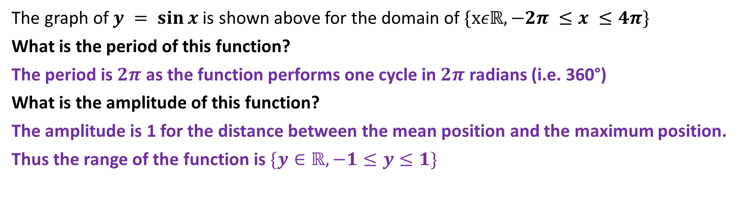

$$y=sin x$$
The graph of $y = sin⁡x$is shown above for the domain of $\{xεℝ,−2π ≤x ≤4π\}$
What is the period of this function?
The period is $2π$ as the function performs one cycle in $2π$ radians (i.e. 360°)
What is the amplitude of this function?
The amplitude is 1 for the distance between the mean position and the maximum position.
Thus the range of the function is $\{y∈ℝ,−1≤y≤1\}$

Slide 3
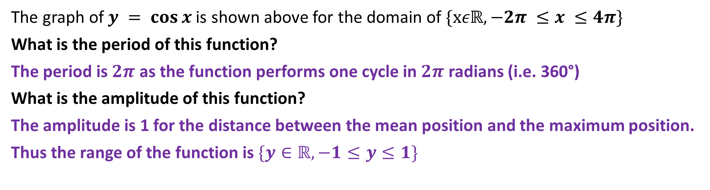

$$y=cos x$$
The graph of $y = cos⁡x$is shown above for the domain of $\{xεℝ,−2π ≤x ≤4π\}$
What is the period of this function?
The period is $2π$ as the function performs one cycle in $2π$ radians (i.e. 360°)
What is the amplitude of this function?
The amplitude is 1 for the distance between the mean position and the maximum position.
Thus the range of the function is $\{y∈ℝ,−1≤y≤1\}$

Slide 4
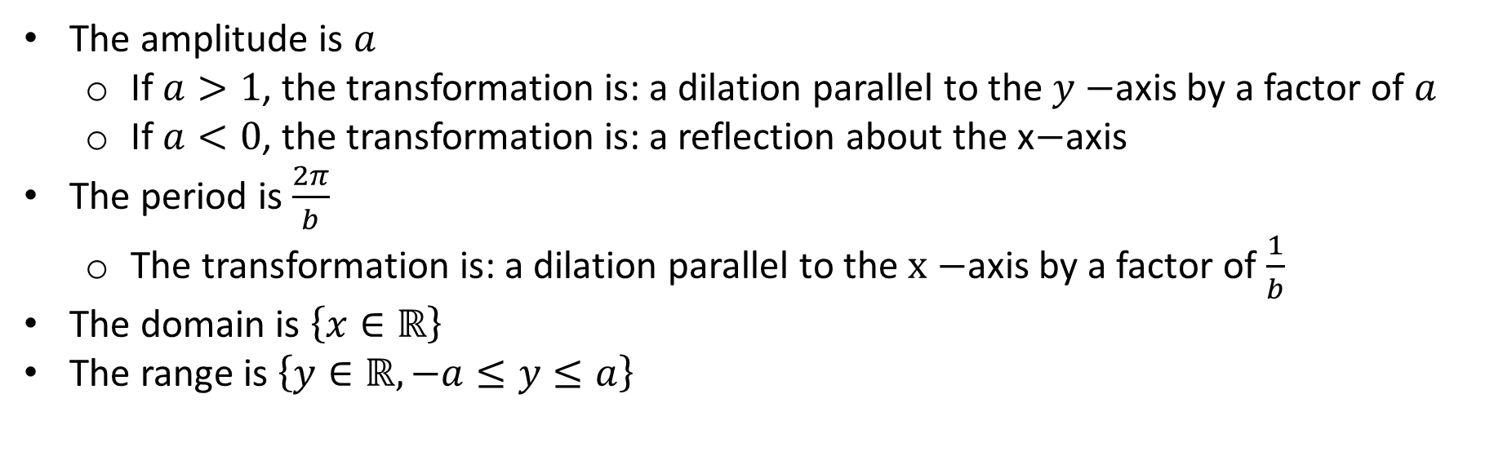

Summary Part 1
Given a trigonometric function (sine or cosine), $f(x)$
$$y=af\left(bx\right)$$
$$y=a\sin{(bx)}or y=acos⁡(bx)$$
The amplitude is $a$
If $a>1$, the transformation is: a dilation parallel to the $y−$axis by a factor of $a$
If $a<0$, the transformation is: a reflection about the x$−$axis
The period is $\frac{2π}{b}$
The transformation is: a dilation parallel to the $x−$axis by a factor of $\frac{1}{b}$
The domain is $\left\{x∈ℝ\right\}$
The range is $\left\{y∈ℝ, −a≤y≤a\right\}$

Slide 5
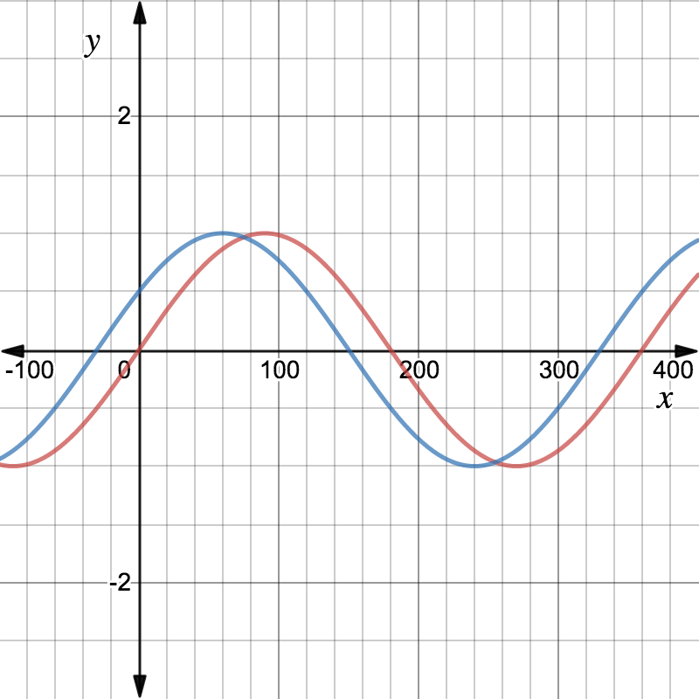
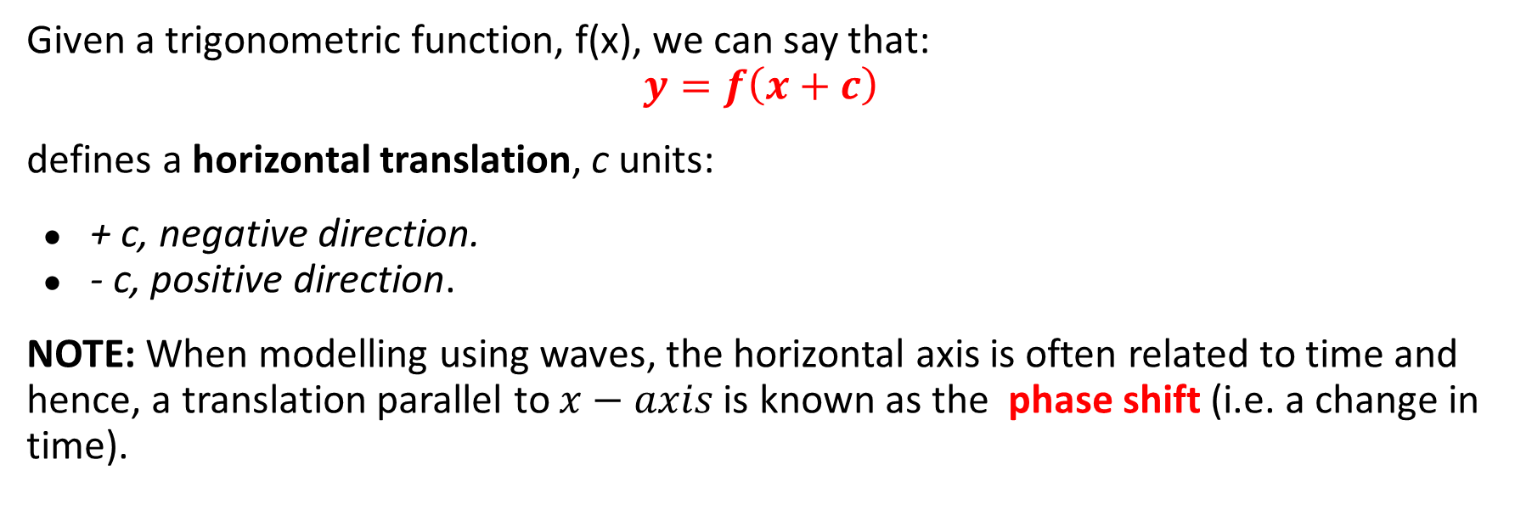
Horizontal Translation
Concept Development
Given a trigonometric function, f(x), we can say that:
$$y=f\left(x+c\right)$$
defines a horizontal translation, c units:
+ c, negative direction.
- c, positive direction.
NOTE: When modelling using waves, the horizontal axis is often related to time and hence, a translation parallel to $x−axis$ is known as the phase shift (i.e. a change in time).
A phase shift alone does NOT change the amplitude or period.

Slide 6



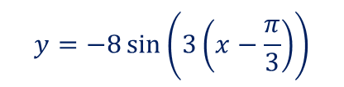

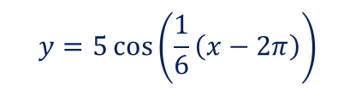



Guided Practice
State the amplitude, period and phase shift of the following trigonometric functions:
a) $y = 2 sin⁡(2(x + 40°))$
b) $y = −8\sin{(3x−π)}$
c) $y = 5\cos\left(\frac{1}{6} x −\frac{π}{3}\right)$
Amplitude=$2$
Period=$\frac{2π}{b}=\frac{2π}{2}=π$
The phase shift: horizontal translation to the left by $40° unit$
$$y=−8\sin\left(3\left(x−\frac{π}{3}\right)\right)$$
Amplitude$=8$
P$eriod=\frac{2π}{3}$
The phase shift: horizontal translation to the right by $\frac{π}{3}unit$
$$y=5\cos\left(\frac{1}{6}\left(x−2π\right)\right)$$
Amplitude$=5$
P$eriod=12π$
The phase shift: horizontal translation to the right by $2πunit$

Slide 7
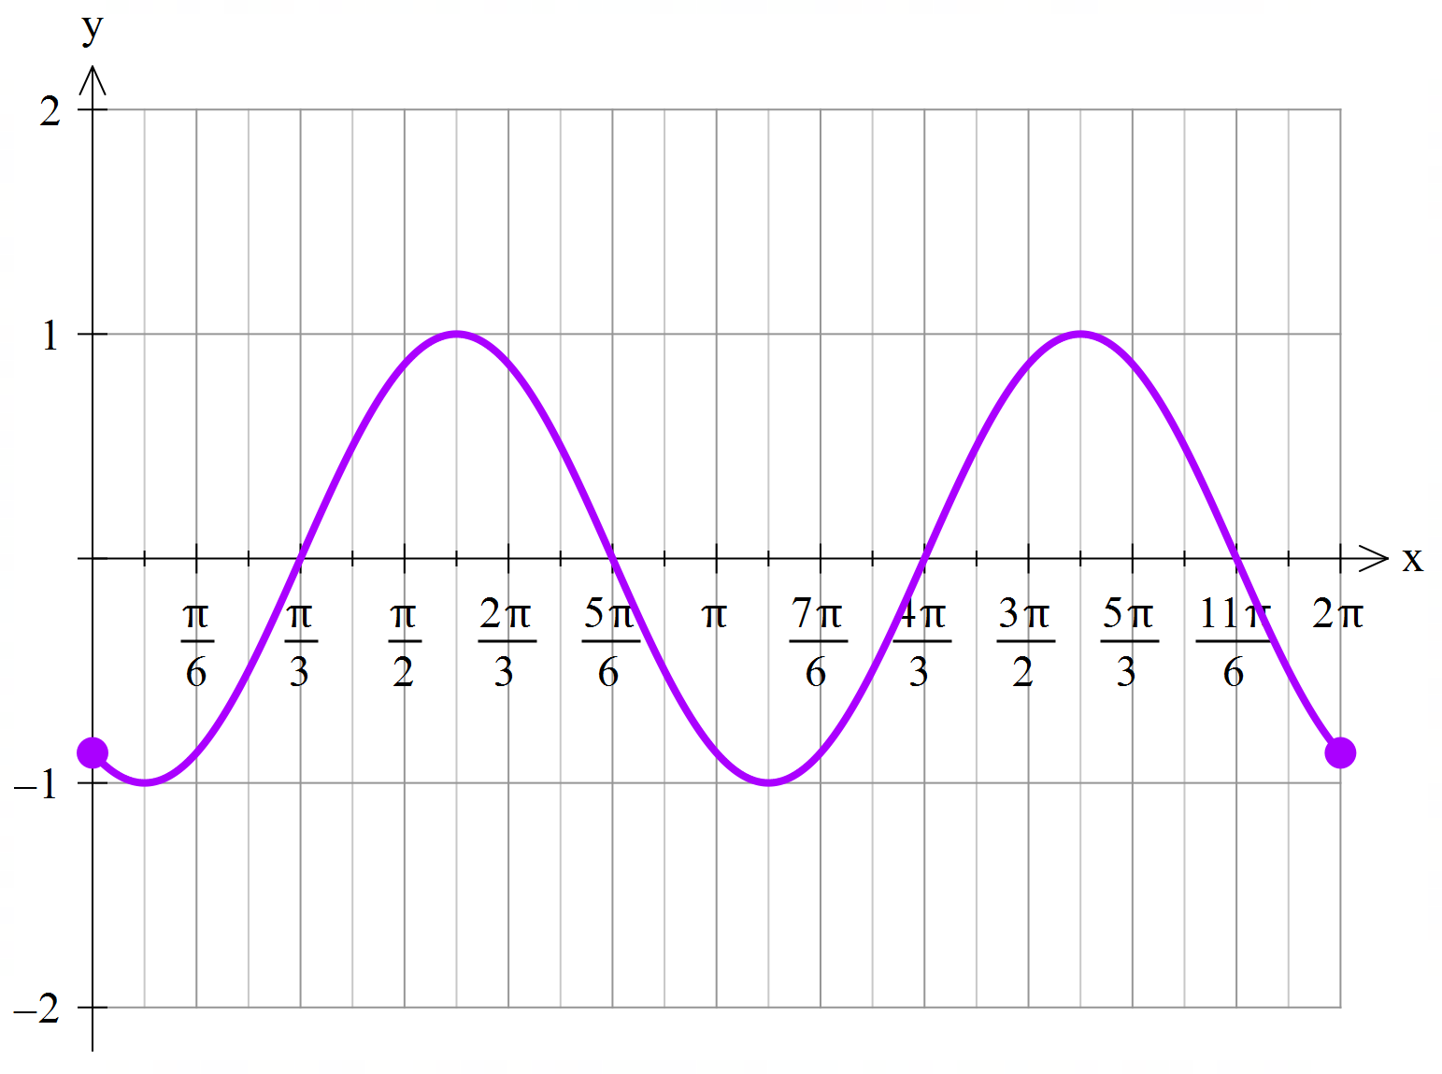










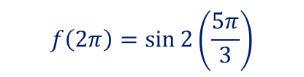



Guided Practice
For the function $f:\left[0,2π\right]→ ℝ, f\left(x\right)=\sin{2\left(x−\frac{π}{3}\right)}$
a) Find $f\left(0\right), f(2π)$
b) Sketch the graph $f$
$$f\left(0\right)=\sin\left(−\frac{2π}{3}\right)$$
$$f\left(2π\right)=\sin{2\left(\frac{5π}{3}\right)}$$
$$=−sin\left(\frac{π}{3}\right)$$
$$=\sin\left(\frac{10π}{3}\right)$$
$$=−\frac{\sqrt{3}}{2}$$
$$=−\frac{\sqrt{3}}{2}$$
Amplitude$=2$
P$eriod=π$
$$y−intercept, x=0, f\left(0\right)=−\frac{\sqrt{3}}{2}⇒\left(0,\frac{−\sqrt{3}}{2}\right)$$
The phase shift: horizontal translation to the right by $\frac{π}{3}unit$
$$x−intercept, y=0, sin2\left(x−\frac{π}{3}\right)=0, 0≤x≤2π$$
$$sin2\left(x−\frac{π}{3}\right)=0, 0≤2\left(x−\frac{π}{3}\right)≤2\left(2π−\frac{π}{3}\right)$$
$$sin2\left(x−\frac{π}{3}\right)=0, 0≤2\left(x−\frac{π}{3}\right)≤\frac{10π}{3}$$
$$2\left(x−\frac{π}{3}\right)=0,π,2π,3π$$
$$x=\frac{π}{3},\frac{5π}{6},\frac{4π}{3},\frac{11π}{6}$$
$$x−\frac{π}{3}=0,\frac{π}{2},π,\frac{3π}{2}$$

Slide 8
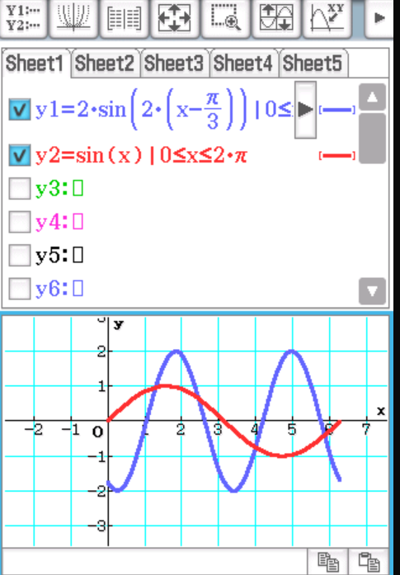
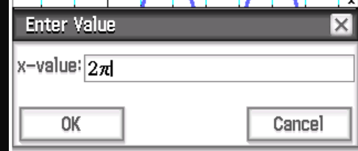
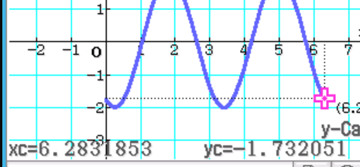






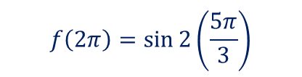


Guided Practice
For the function $f:\left[0,2π\right]→ ℝ, f\left(x\right)=\sin{2\left(x−\frac{π}{3}\right)}$
a) Find $f\left(0\right), f(2π)$
b) Sketch the graph $f$
$$f\left(0\right)=\sin\left(−\frac{2π}{3}\right)$$
$$f\left(2π\right)=\sin{2\left(\frac{5π}{3}\right)}$$
$$=−sin\left(\frac{π}{3}\right)$$
$$=\sin\left(\frac{10π}{3}\right)$$
$$=−\frac{\sqrt{3}}{2}$$
$$=−\frac{\sqrt{3}}{2}$$
Amplitude$=2$
P$eriod=π$
The phase shift: horizontal translation to the right by $\frac{π}{3}unit$

Slide 9
Skill Development
Sketching Sine and Cosine graph, $f:\left[m,n\right]→ ℝ, f\left(x\right)=a\sin{b\left(x±c\right)±d}$
Step 1: Determine starting point of graph, $f(m)$
Step 2: Determine ending point of graph, $f(n)$
Step 3: Determine amplitude $=a$,
Step 4: Determine period $=\frac{2π}{b}$, informs how many cycles of the graph per the domain given.
Step 5: Determine the transformation to obtain new turning point
Step 6: Determine $y−$intercept , substitute $x=0$ to determine $f(0)$
Step 7: Determine $x−$intercept , substitute $f(x)=0$, obtain new domain to suit period change and solve for $x$
Step 8: Sketch the graph showing start and end coordinates, turning points, $y−$intercept and $x−$intercept

Slide 10

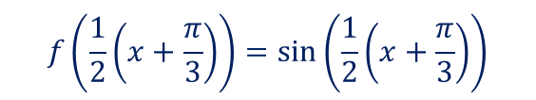
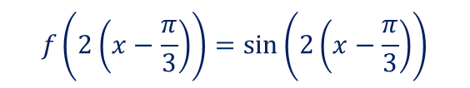
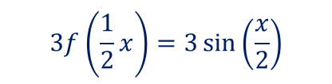
Guided Practice
Find the equation of the image of $y=\sin{x}$ for each of the following transformations:
a) d$ilation of factor 2 from the y−$ axis followed by dilation of factor 3 from the x axis
b) d$ilation of factor\frac{1}{2} from the y−$ axis followed by translation of factor $\frac{π}{3}$ units in the positive x-axis
c) d$ilation of factor 2 from the y−$ axis followed by translation of factor $\frac{π}{3}$ units in the negative x-axis
$$3f\left(\frac{1}{2}x\right)=3\sin\left(\frac{x}{2}\right)$$
$$f\left(2\left(x−\frac{π}{3}\right)\right)=\sin\left(2\left(x−\frac{π}{3}\right)\right)$$
$$f\left(\frac{1}{2}\left(x+\frac{π}{3}\right)\right)=\sin\left(\frac{1}{2}\left(x+\frac{π}{3}\right)\right)$$

Slide 11
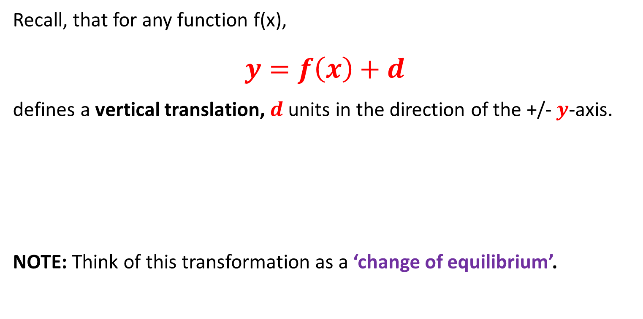
Vertical Translation
Concept Development
Recall, that for any function f(x),
$$y=f\left(x\right)+d$$
defines a vertical translation, $d$ units in the direction of the +/- $y$-axis.
NOTE: Think of this transformation as a ‘change of equilibrium’.
If d > 0, “up”
If d < 0, “down”

Slide 12
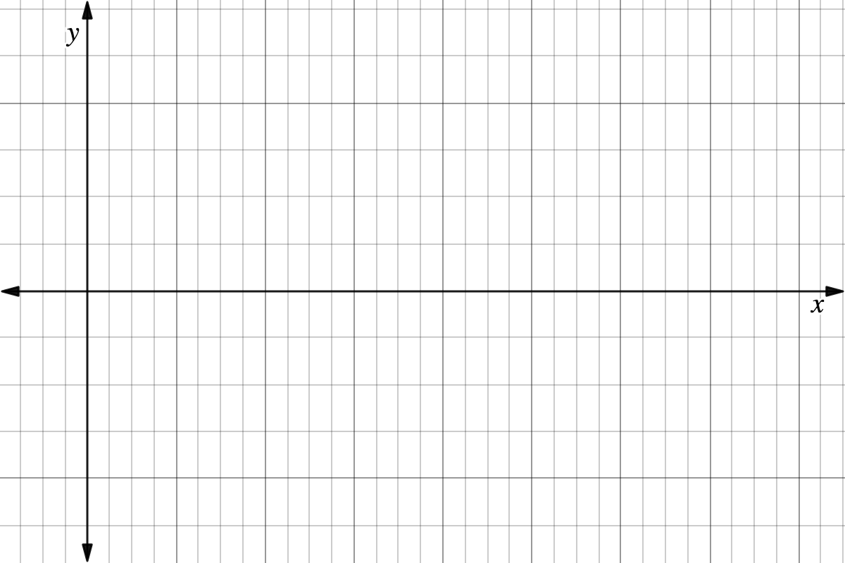
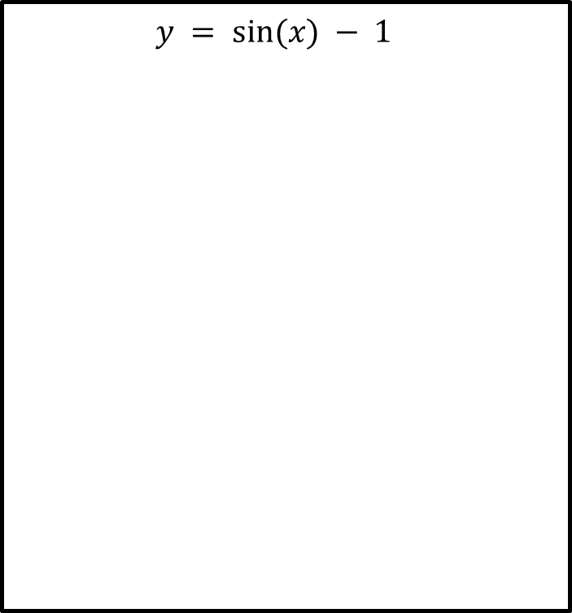

On the axes provided, sketch the following over the domain 0 ≤ x ≤ 2𝜋.
Guided Practice
$$y = sin⁡(x) − 1$$
Amplitude = 1
Period = $2π$

Slide 13



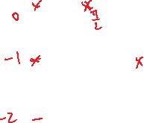


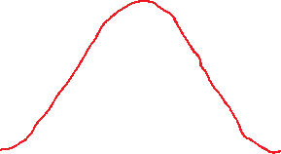


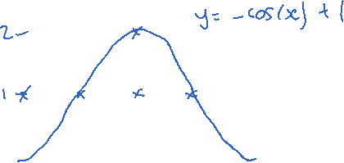

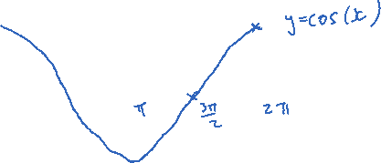
On the axes provided, sketch the following over the domain 0 ≤ x ≤ 2𝜋.
Guided Practice
$$y = 1 − cos⁡(x)$$
$$y=−\cos\left(x\right)+1$$
Amplitude = $1$
Period = $2π$
$y−$intercept, $x=0, y=−\cos\left(0\right)+1=0$ $$y−int: (0,0)$$
$x−$intercept, $y=0, 0=−\cos\left(x\right)+1$ $$\cos\left(x\right)=1, 0≤x≤2π$$
$$x=0, 2π$$
$$x−int:\left(0,0\right), (2π,0)$$

Slide 14
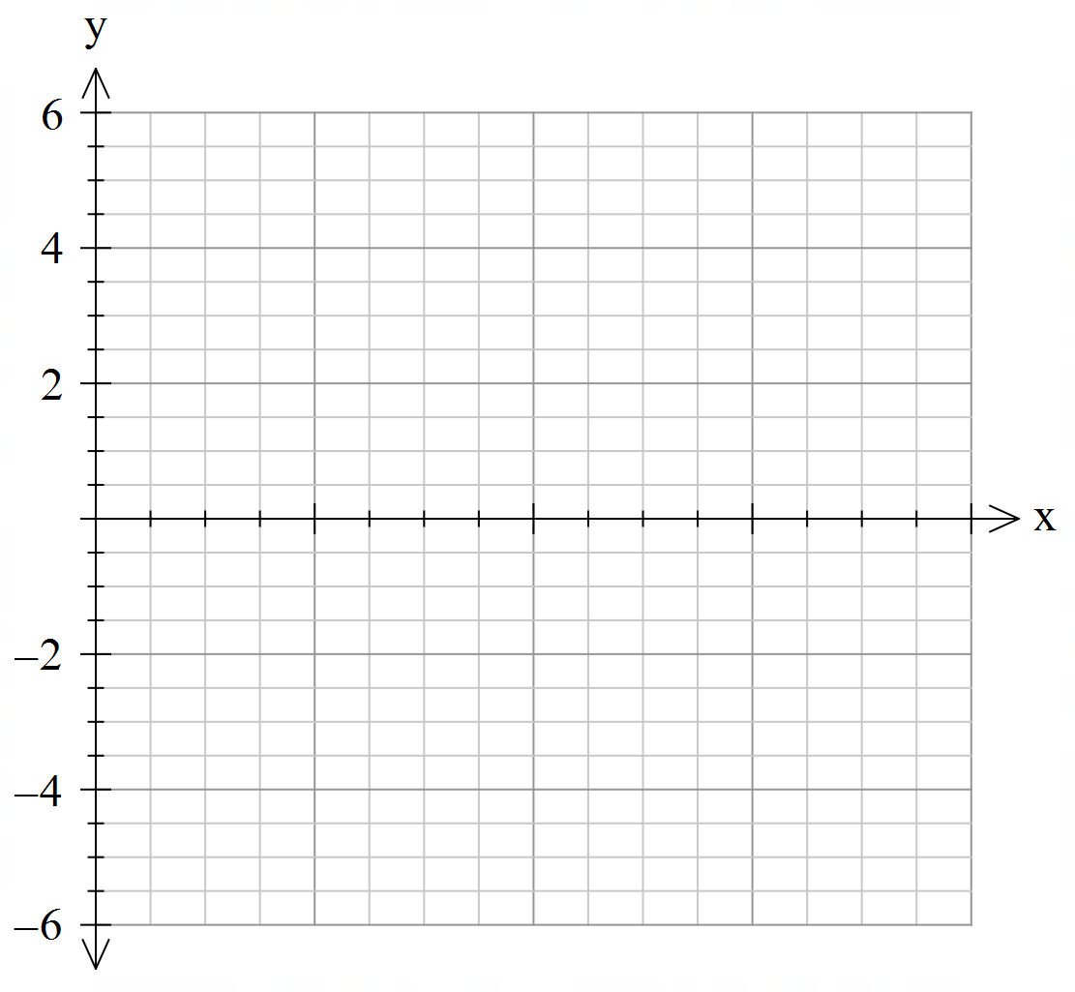








Sketch the function on the axes below
Guided Practice
$$y = 2\sin\left(2x\right)−2$$
over the domain $0≤x≤2π$
Amplitude = $2$
Period = $π$
Translates vertically downwards by 2
$y−$intercept, $x=0, y=−2$ $$y−int: (0,−2)$$
$x−$intercept, $y=0, 0=2\sin\left(2x\right)−2$ $$\sin{(2x)}=1, 0≤2x≤4π$$
$$2x=\frac{π}{2},\frac{5π}{2}$$
$$x=\frac{π}{4},\frac{5π}{4}$$
$$x−int:\left(\frac{π}{4},0\right), \left(\frac{5π}{4},0\right)$$

Slide 15
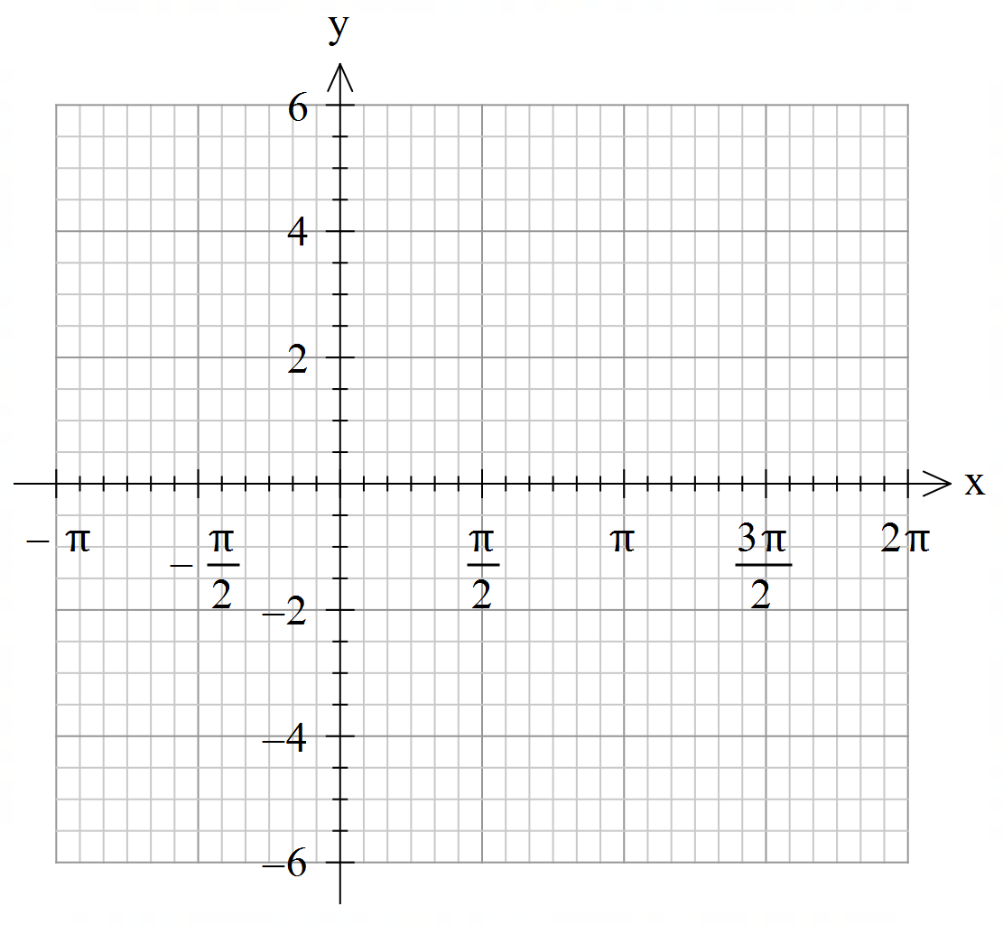
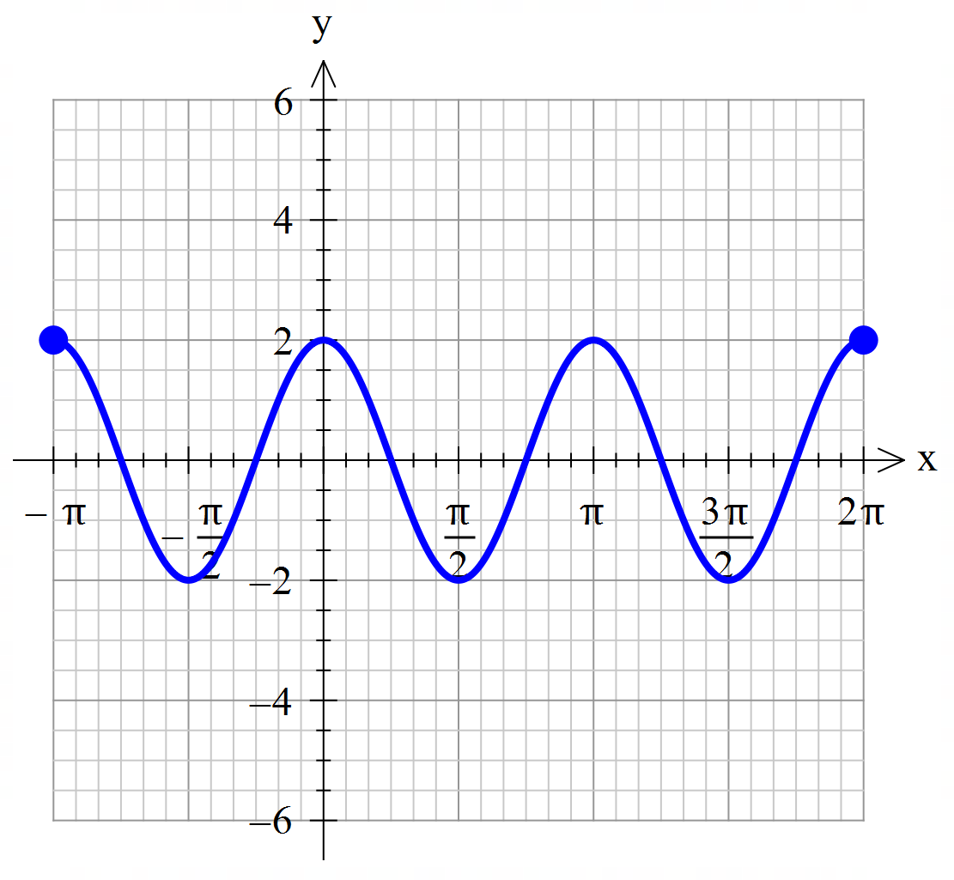
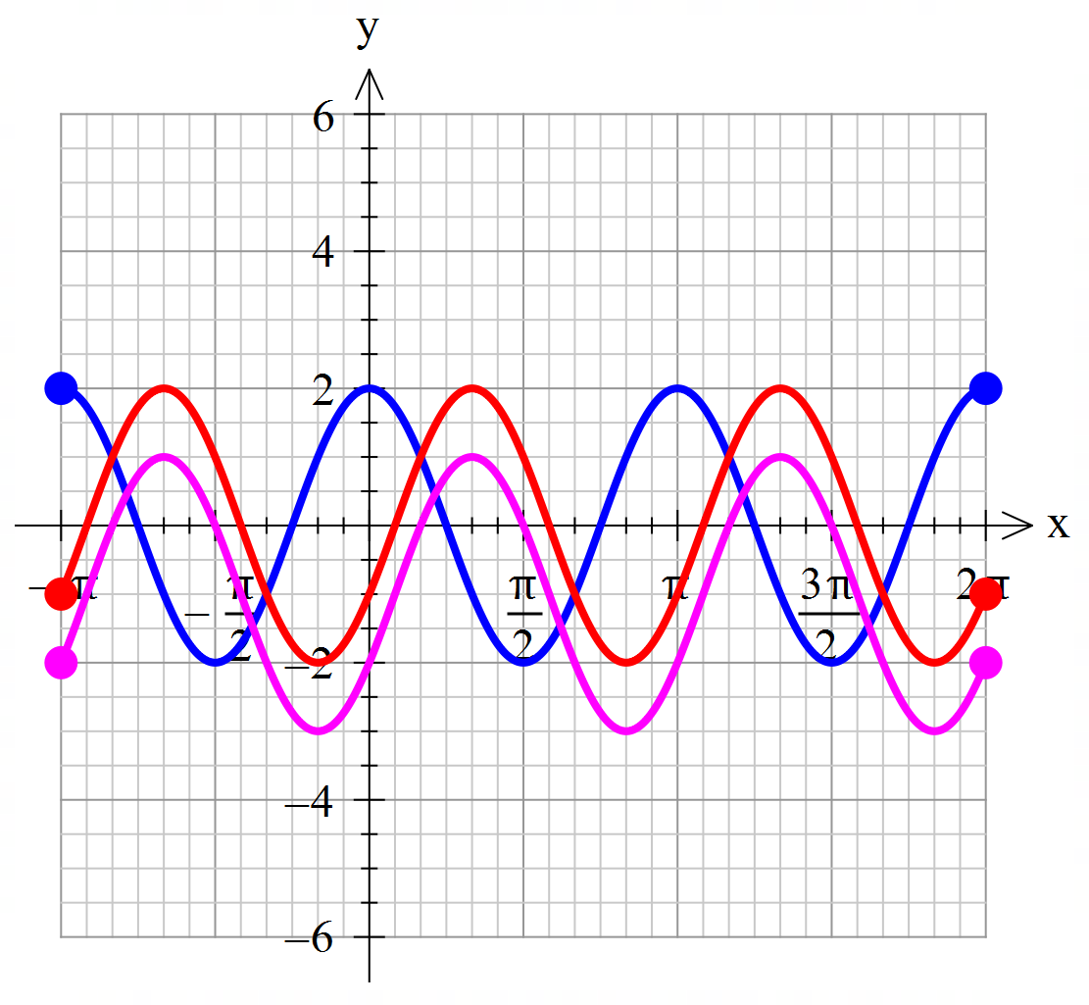
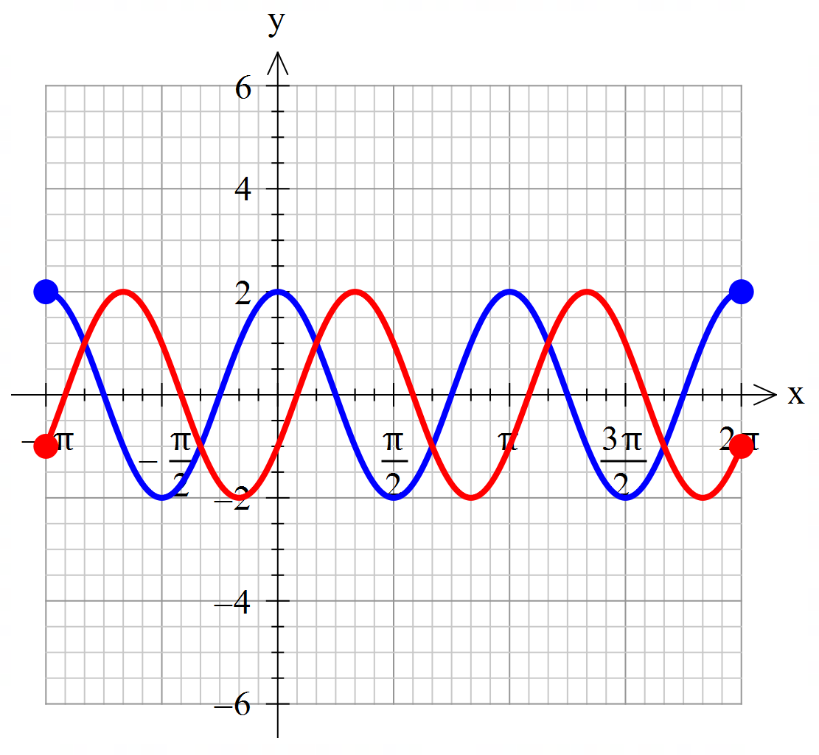
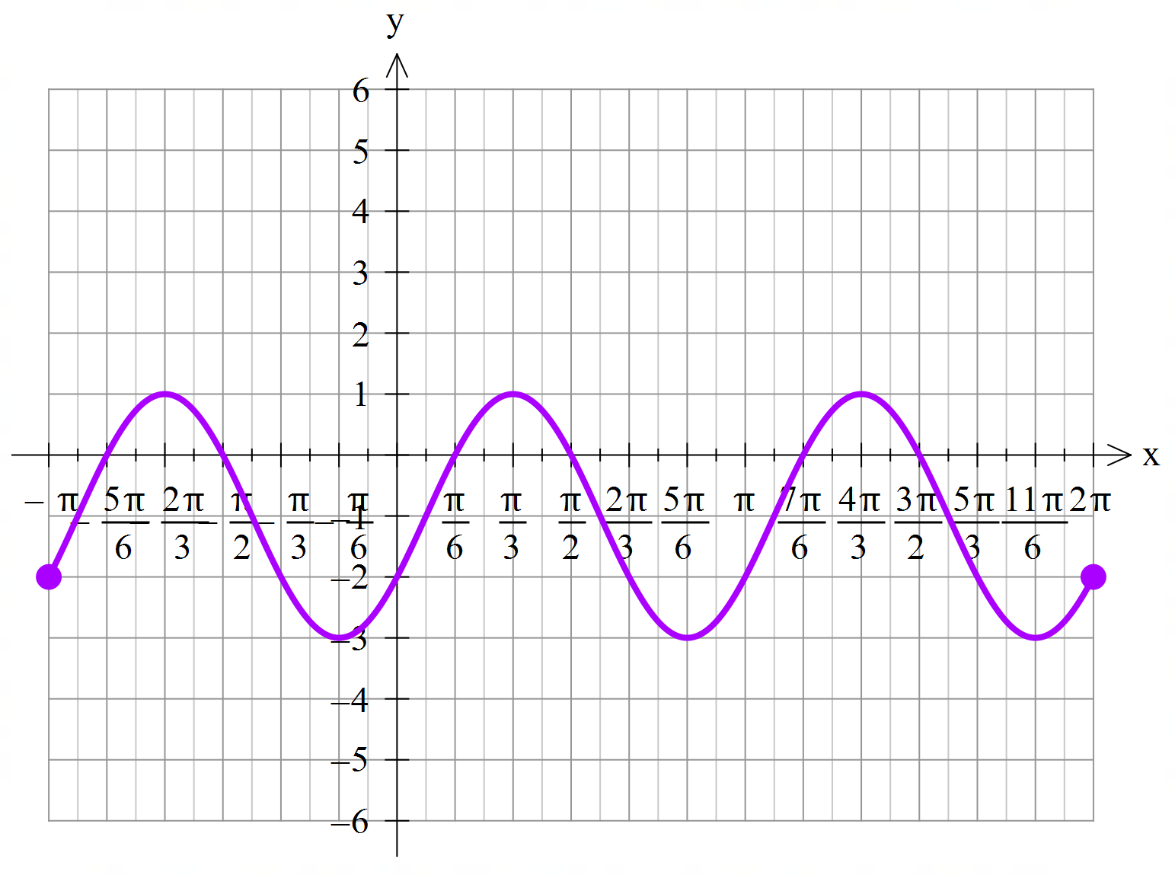

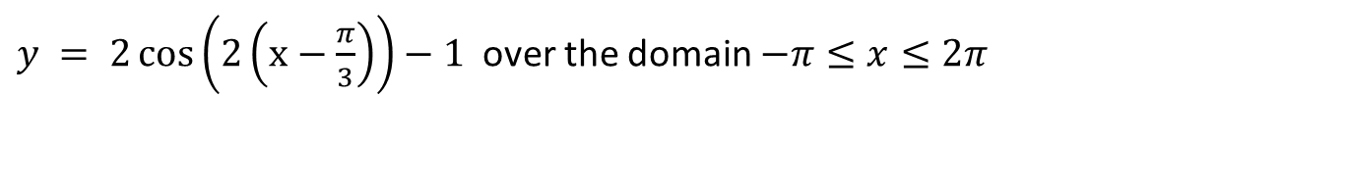



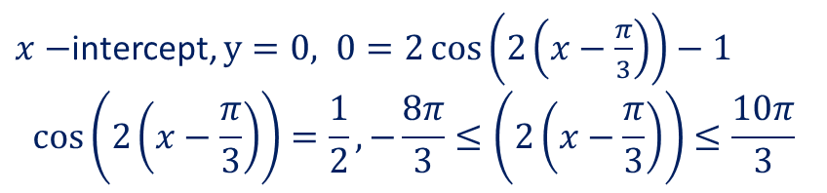




Sketch the function on the axes below
Guided Practice
$y = 2\cos\left(2\left(x−\frac{π}{3}\right)\right)−1$ over the domain $−π≤x≤2π$
Amplitude = $2$
Period = $π$
Translates horizontally right by $\frac{π}{3}$
Translates vertically down by $1$
Solve for $y$ when $x=−π, x=2π$
$$f\left(−π\right)=−2 \\ f\left(2π\right)=−2$$
$y−$intercept, $x=0, y=−2$ $$y−int: (0,−2)$$
$x−$intercept, $y=0, 0=2\cos\left(2\left(x−\frac{π}{3}\right)\right)−1$ $$\cos\left(2\left(x−\frac{π}{3}\right)\right)=\frac{1}{2}, −\frac{8π}{3}≤\left(2\left(x−\frac{π}{3}\right)\right)≤\frac{10π}{3}$$
$$2\left(x−\frac{π}{3}\right)=−\frac{7π}{3},−\frac{5π}{3},−\frac{π}{3},\frac{π}{3},\frac{5π}{3},\frac{7π}{3}$$
$$x=−\frac{5π}{6},−\frac{π}{2},\frac{π}{6},\frac{π}{2},\frac{7π}{6},\frac{3π}{2}$$

Slide 16
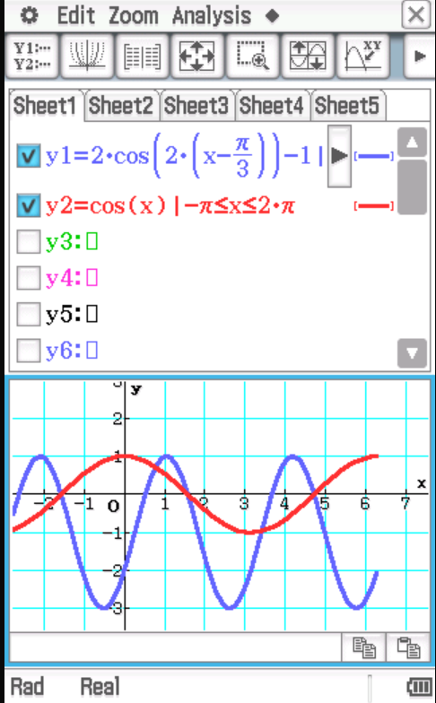


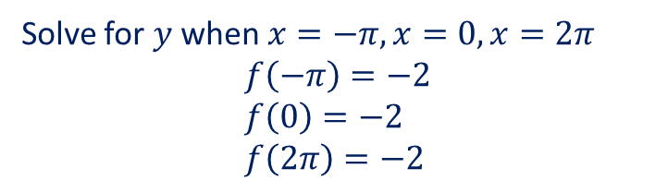



Sketch the function on the axes below
Guided Practice
$$y = 2\cos\left(2\left(x−\frac{π}{3}\right)\right)−1$$
over the domain $−π≤x≤2π$
Amplitude = $2$
Period = $π$
Translates horizontally right by $\frac{π}{3}$
Translates vertically down by $1$
Solve for $y$ when $x=−π, x=0, x=2π$
$$f\left(−π\right)=−2 \\ f\left(0\right)=−2 \\ f\left(2π\right)=−2$$

Slide 17
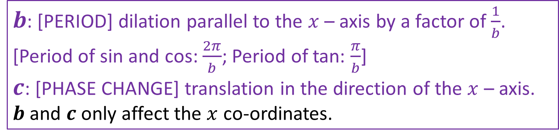

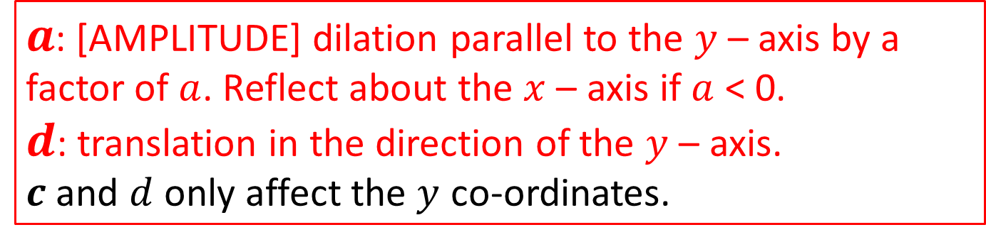
$$f\left(x\right)→af(b\left(x±c\right))±d$$
$b$: [PERIOD] dilation parallel to the $x$ – axis by a factor of $\frac{1}{b}$. [Period of sin and cos: $\frac{2π}{b}$; Period of tan: $\frac{π}{b}$]
$c$: [PHASE CHANGE] translation in the direction of the $x$ – axis.
$b$ and $c$ only affect the $x$ co-ordinates.
$a$: [AMPLITUDE] dilation parallel to the $y$ – axis by a factor of $a$. Reflect about the $x$ – axis if $a$ < 0.
$d$: translation in the direction of the $y$ – axis.
$c$ and $d$ only affect the $y$ co-ordinates.

Slide 18
Guided Practice
Describe the transformations below in the order that they occur:
f(x) = sin(x) → g(x) = 2 sin(2(x + 40°)) + 1
Dilation parallel to the $y−$ axis by a factor of $2$
Vertical translation in the positive $y−$direction by $1 unit$
Dilation parallel to the $x−$ axis by a factor of $2$
Horizontal translation in the n$egative x−$direction by $40°$

Slide 19
Independent Practice
Complete Cambridge Ex 12I, 12J

